Slide 1
Through the lens
Munich | 18.01.2019 | Martin Lechner

Slide 2
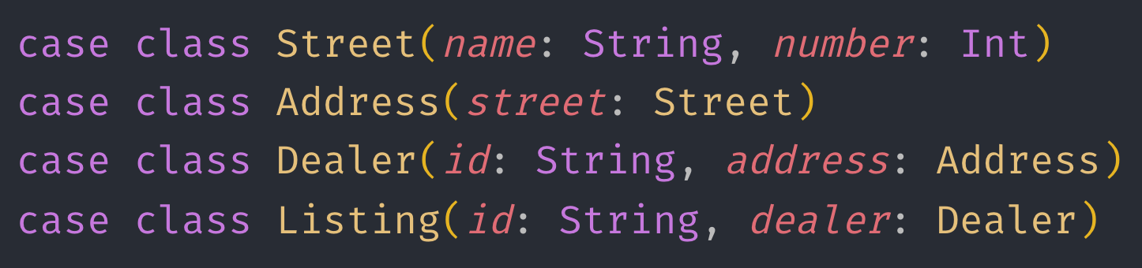
Problem
Notes:
We have a case class hierarchy and want to fix a mistake in the lowest level. The street name should be capitalized, how do we do that?

Slide 3
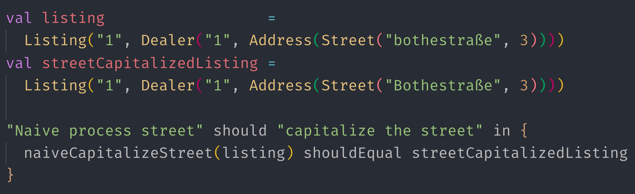
TDD style
Notes:
First of all let’s write a test!
Fair enough…

Slide 4
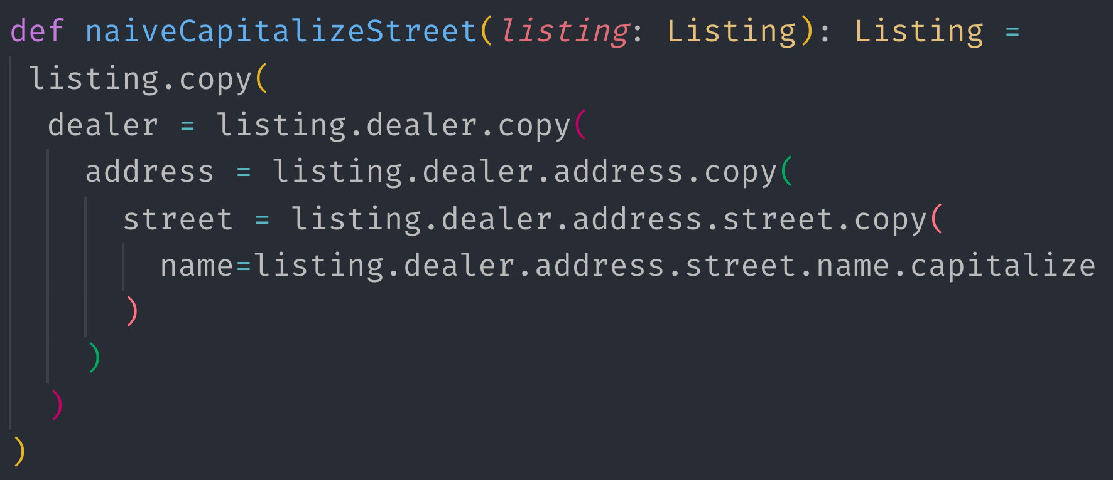
Naive solution
Notes:
The naïve solution calls the nested copy constructors overriding parts of the hierarchy. Much boilerplate. Not very readable. Intent is not clear on first sight

Slide 5
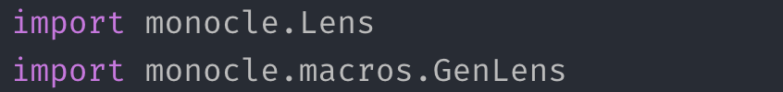
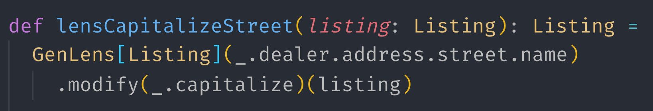
Can we do better?
Notes:
Turns out we can do better! There is a library called Monocle which provides us with optics. This code does the same thing as what was show n on the last slide.

Slide 6


How is it working?
Notes:
How is it working? A lens allows us to zoom into a Product type, e.g. case classes. It’s two defining operations are get and set. You define a Lens by specifying those two as shown on the slide. _.id is get and the copying is the set function. Now you are ready to use your lens.
To be honest this is not very spectacular, but we’ll see what makes it really cool!

Slide 7

Modify
Notes:
Modify allows you to apply a function on the zoomed in part by the lens. It still changes the value in place in a immutable way!

Slide 8
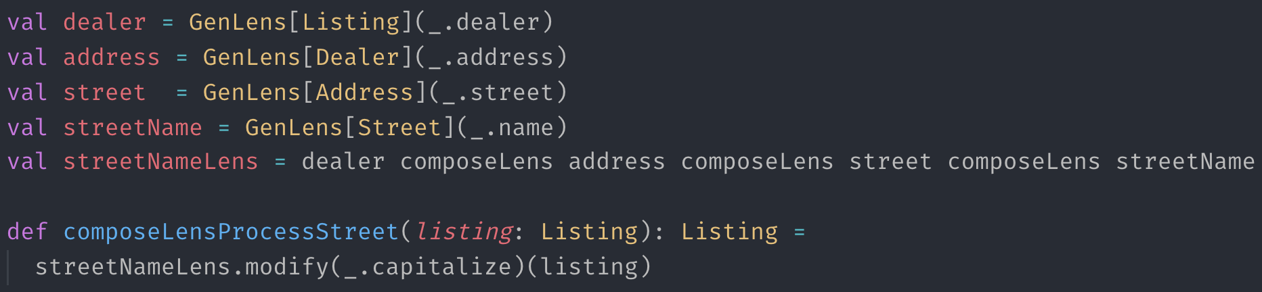
Lenses compose
Notes:
GenLens is a macro to generate the lenses by specifying the getter on product types. As we see here Lenses do compose and that’s what makes it really cool. Here we specify a lens for each level and re-compose them to a new lens spanning all levels. You might also take the dealer lens and compose with the id lens we’ve seen earlier to zoom into the dealer id.

Slide 9
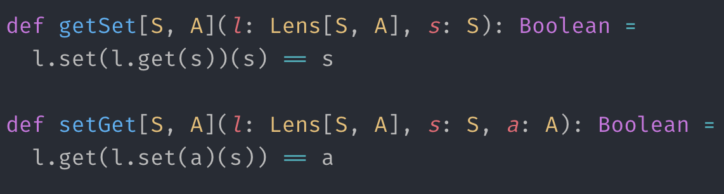
Lens Laws
Notes:
To be a Lens the lenses have to obey two laws. This ensures the composability of the lenses.

Slide 10
Beyond Scala
Idea originates from Haskell
Typescript: https://github.com/gcanti/monocle-ts
Ramda
Elm
…
Notes:
The idea originates from Haskell, but was also picked up in the frontend world. For typescript there is monocle-ts. Ramda also contains lenses. You might ask why you need this there? If you work with redux you might not want to mutate the underlying structure…

Slide 11
Thank you
Register for the functional programming workshop with Luka Jacobowitz, core Maintainer of Cats!
http://julien-truffaut.github.io/Monocle/
http://julien-truffaut.github.io/Monocle/optics/lens.html
https://blog.scalac.io/optics-beyond-lenses-with-monocle.html
Code inkl. Tests: https://github.com/martinlechner1/lightning-talk-lenses

Slide 12
Beyond lenses
Monocle also contains Prisms to work with Sum Types and many other useful typeclasses
Notes:
Extra slide in case there is time

